Slide 1
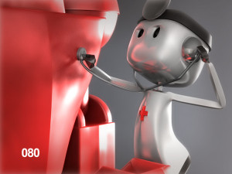
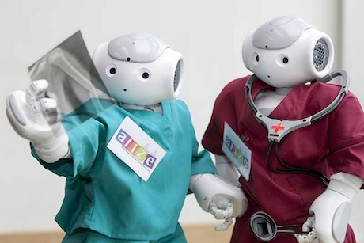
Robotics in Healthcare
Johnathan Aspinwall
Chris Card
Vicente Gonzalez
Ryan Langewisch
Tim Nygren
Charles Tandy

Slide 2
Outline
Intro
Surgical robot
Autonomous telepresence robot for general checkups
Conclusion

Slide 3
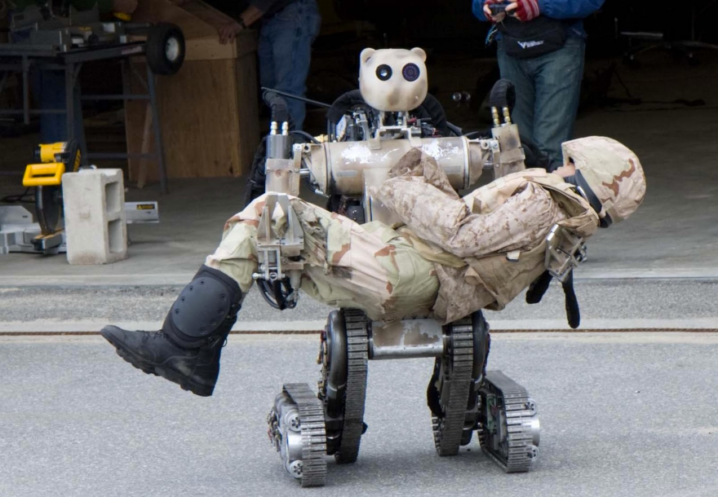
Intro
Robots are just making their way into healthcare
Challenges:
Safety
Overcoming mistrust of patients
Dexterity of manipulators

Slide 4
Intro cont.
Benefits:
Reduce cognitive load on healthcare workers
Allow healthcare workers to handle more patients
Reduce infection rates and operating costs
Increase effectiveness of surgery
We will cover two robots in this field, the HeartLander and RP-VITA

Slide 5
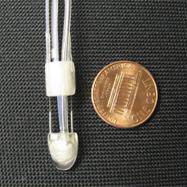
HeartLander
Picture - http://www.cmu.edu/homepage/innovation/2007/summer/bot-moves-with-the-beat.shtml

Slide 6
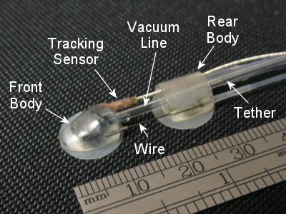
Characteristics
Size – Penny sized
Movement – worm-like
Manipulate – Tool port
Sensing – Tracking sensor
Think – Semi-autonomous Movement
Picture - http://www.cs.cmu.edu/~./heartlander/design.html#Locomotion

Slide 7
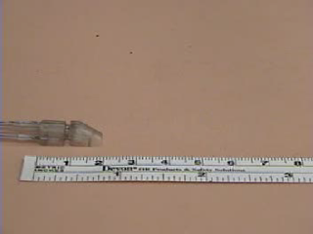
Video - http://www.cs.cmu.edu/~./heartlander/videos.html

Slide 8
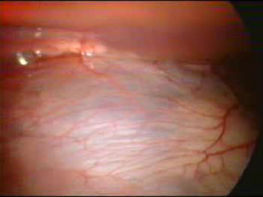
Video - http://www.cs.cmu.edu/~./heartlander/videos.html

Slide 9
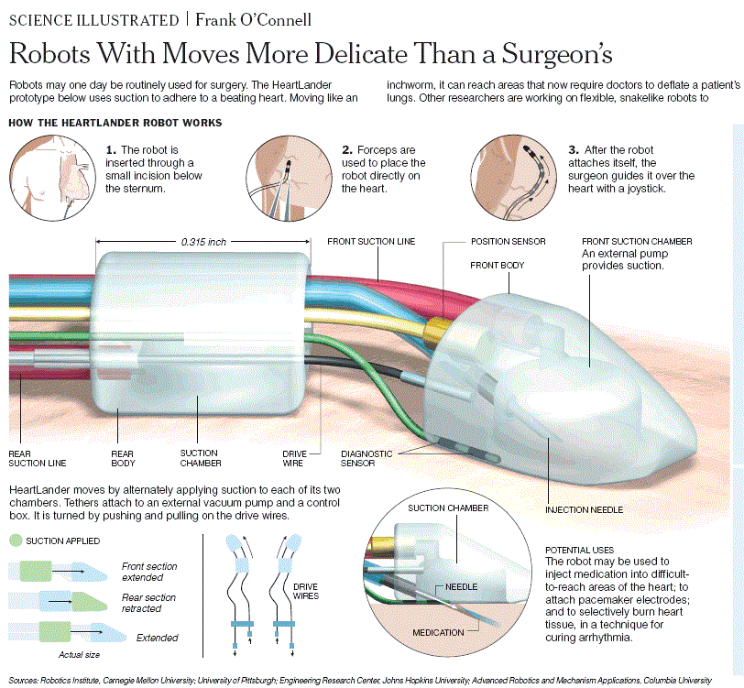
Intelligence?

Slide 10
Adaptable
Pure pursuit-tracking algorithm
Sensors:
position
diagnostic

Slide 11
Limitations
Tethered robot, rigid mobility
Size currently 8mm wide, 5mm tall and about 10mm long
2 Applications
pacing and dye marks

Slide 12
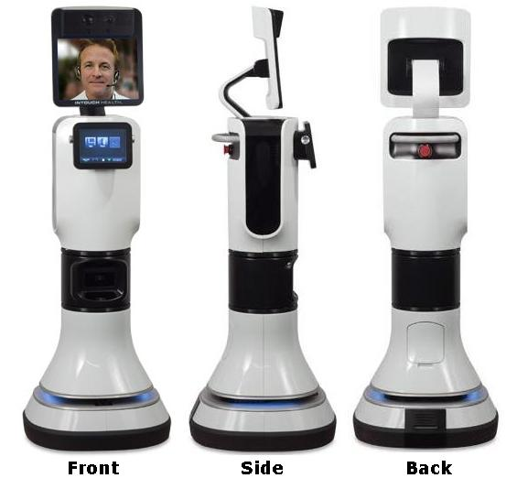
RP-Vita
Characteristics
Remote telepresence
Group conferencing with specialists
Lower chances of errors
Access to medical record database

Slide 13
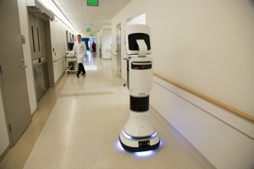
RP-Vita
Autonomous navigation
Send to location by screen press
Obstacle detection and avoidance
Remote diagnosis through sensors
Digital stethoscope
Ultrasound
Otoscope (that thing docs use to look in ur ears)

Slide 14

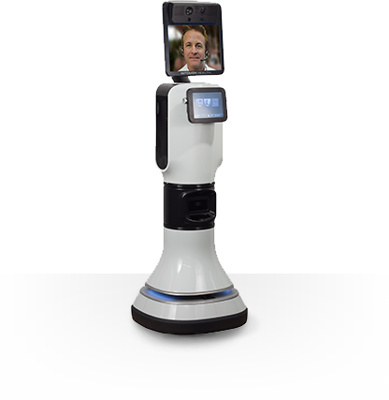
RP-VITA Intelligence
Limited independent decision making
Primary area of intelligence is in movement
Path finding
Adapt to hospital setting
Distinguishes from other computers/equipment

Slide 15
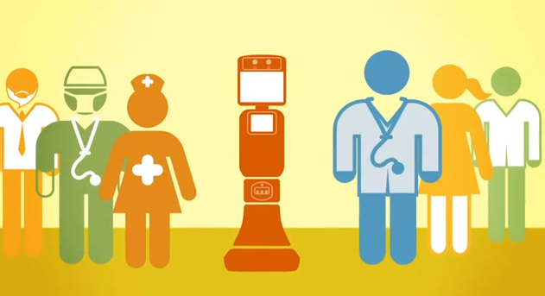
RP-VITA Limitations
Only as effective as the doctor using it
Still achieves the goals of the design
Challenging field to separate human control

Slide 16
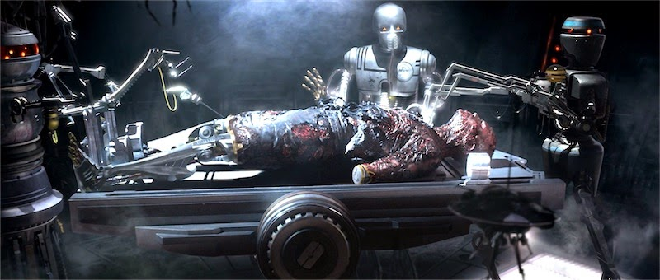
The Perfect Healthcare Robot
Fully automated diagnosis of patients.
Fully automated surgeries.

Slide 17
Observations/Questions Raised
Are we ready?
Will people trust robots to diagnose and treat them?

